Slide 1
CSC111
Introduction to Computer Science
Course Instructors:
Prof. B. S. Aribisala
Dr. U. C. Ogude
Department of Computer Science
Lagos State of University

Slide 2
Generations and Classification of Computers
Generations of Computers
First generation of computers
Second generation (1959-1971) (Transistors)
Third Generation Computer (1964-1971) (Integrated Circuit)
Fourth Generation (1974-1984) (Very Large Integrated Circuit)
Fifth\future Generation (Present and beyond) (Artificial Intelligence)
Classification of Computers
Classification according to purpose
  General-purpose Computers
  Specific-purpose Computers
Classification according to type of data-handling techniques
Analog Computers
Digital Computers
Hybrid Computers
Classification according to functionality
Microcomputers
Minicomputers
Mainframe computers
Supercomputers

Slide 3
Classification of computers
Computers are available in different sizes and types. Some computers are designed to be used by a single user only, whereas some computers can handle the needs of many users simultaneously.
Computers also differ based on their data-processing abilities. In general, the computers can be classified according to
purpose,
data handling and
functionality

Slide 4
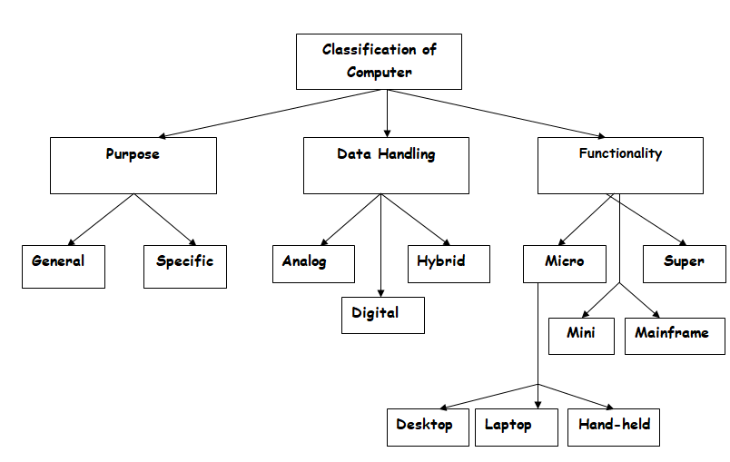
Classification of computers

Slide 5
Classification according to functionality
Based on physical size, performance and application areas, the computers are generally classified into four major categories:
Microcomputers
Minicomputers
Mainframe computers
Supercomputers

Slide 6
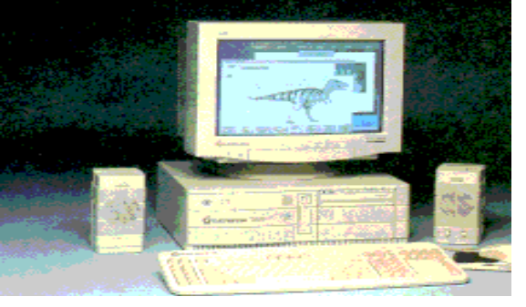
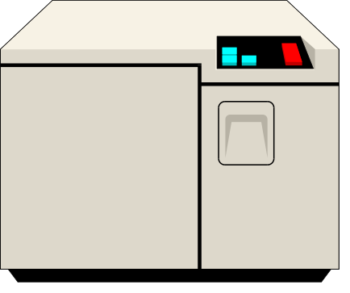
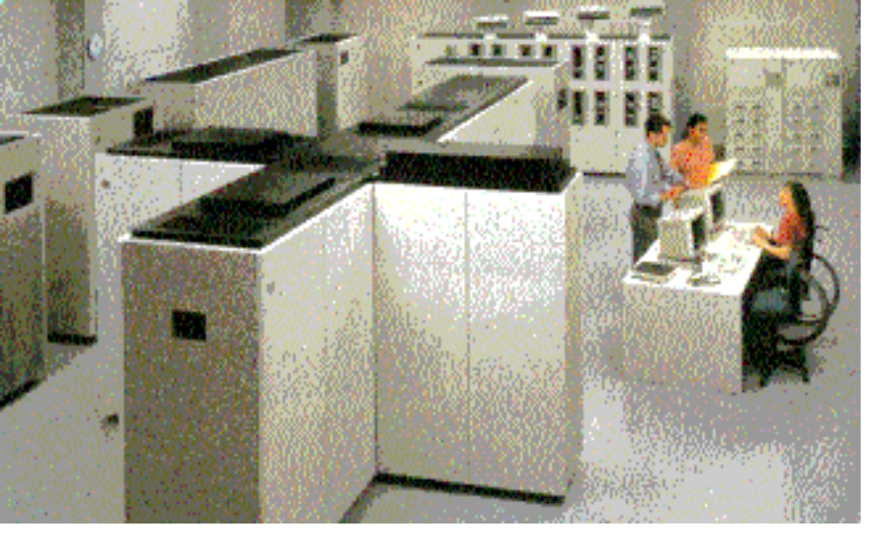
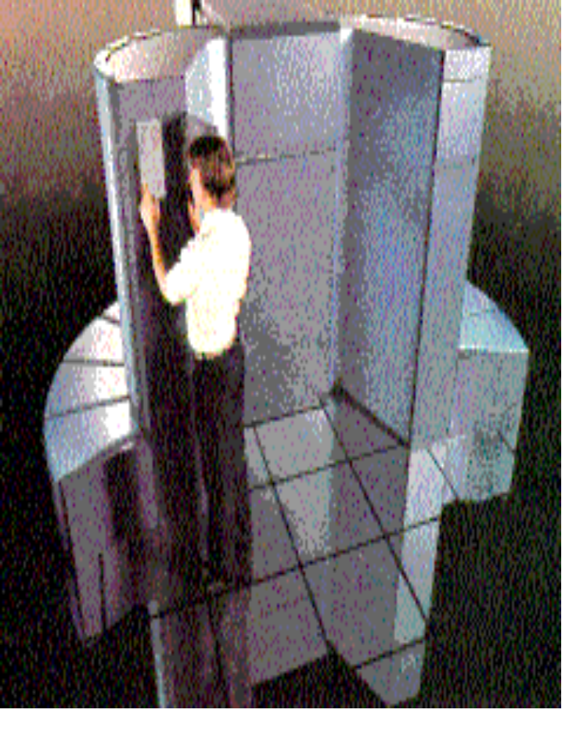
Classification of computers
Microcomputers
2. Minicomputers
3. Mainframe computers
4. Supercomputers

Slide 7
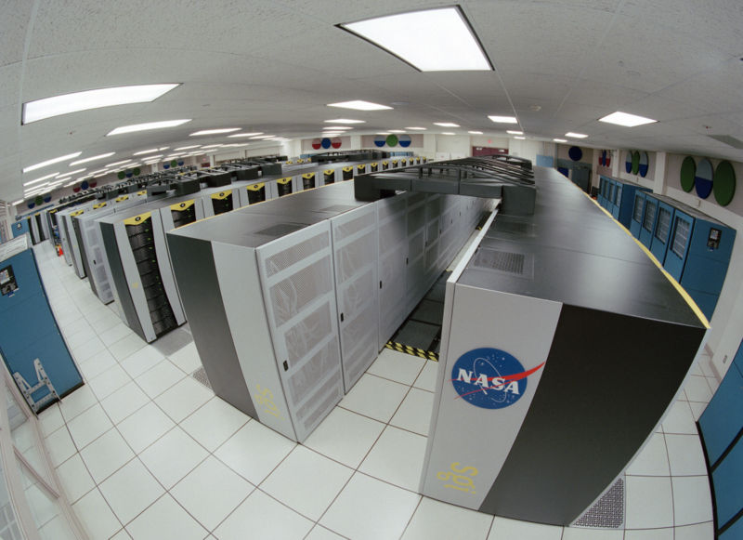
Super Computer (monster)

Slide 8
Super Computer (monster)
An extremely fast computer that can perform hundreds of millions of instructions per second.

Slide 9
Classification of computer by size
Super Computer (monster)
The most powerful of the four categories
Used by very large organizations, particularly for very math-intensive types of tasks
These are the largest, fastest, and most expensive computers.
They have more than 1 CPU which contains instructions so that it can interpret instructions and execute arithmetic and logical operations.
The cost ranges from $100 million to $250 million for design and assembly, apart from the maintenance cost.
The speed of super computer is generally measured in “FLOP” (Floating Point Operation Per Second), instead of million instructions per second (MIPS)
Thousands of users can be connected

Slide 10
Super Computer (monster)
As per 19 April 2018, it has a total of 40PB of internal memory and requires 15,371,00KW of power to operate.
Have storage capacities of millions of bits per chip.
Examples of Super Computer: Crayl, Cray2, Cray 3, Titan, Roadrunner
Uses: Super computer plays a crucial role in the following fields:
Quantum mechanics,
Weather forecasting,
Climate research,
Oil and gas exploration,
Molecular modeling etc.

Slide 11
Mainframe computer
Larger machines with special wiring and environmental controls
Faster processing and greater storage than minicomputers
Typical machine in large organizations
A powerful multi-user computer capable of supporting many hundreds or thousands of users simultaneously.

Slide 12
Mainframe computer
A mainframe computer is next to super computer in terms of prize, size of internal memory and speed.
A main frame cost from $200,000 to several millions of dollars. It has a variety of peripheral devices such as printers, plotters, terminals etc. and large amount of external storage.
A mainframe computer is used to process the large and huge amount of data in petabytes.
They are used mostly in large establishment (e.g. Universities, banks, commercial houses, Organization, factories etc.).
They operate at a speed measured in nano second.
Thousands of users can be connected to it.

Slide 13
Uses of mainframe:
They are mainly used by government institutions and large companies for tasks such as large data processing, census, financial transaction processing etc.
Airline system (in this case, a mainframe is installed at the head office where all the information about flight are recorded, small computers are installed in their various booking office, these computers are attached to central data bank so that up to date information are readily available
Examples: Uivac 1100/10. Univac 1100/60, Honey well DSP88/ 86 IBM

Slide 14
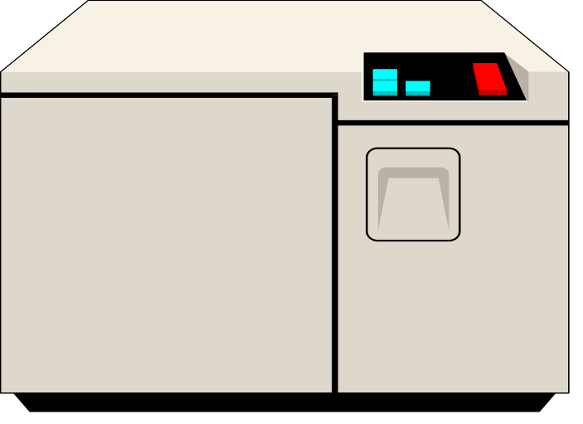
Mini computer
Desk-sized
More processing speed and storage capacity than microcomputers
General data processing needs at small companies
Larger companies use them for specific purposes
A multi-user computer capable of supporting up to hundreds of users simultaneously.

Slide 15
Mini computer
Is a medium sized computer that is more powerful than micro computer?
It is between mainframe and micro computer.
The speeds are rated between one and fifty million instructions per second (MIPS).
They have primary storage in hundred to three hundred megabytes range with access storage device.
It is designed to serve many users simultaneously.
Uses
They are generally used as mid-range servers.
Also for scientific and engineering computations, business transaction handling and data base management etc.
Example: TDC 316, P1W 11/70

Slide 16
Micro computer
Microcomputer =>Personal Computer => PC: A small, single-user computer based on a microprocessor.
There are 3 types of the Microcomputers :
  Laptop
  Desktop
  Workstation
Personal Computer: Workstation: A powerful, single-user computer. A workstation is like a personal computer, but it has :
  a more powerful microprocessor and, in general, a higher-quality monitor.

Slide 17
Micro computer
It is defined as a computer that has microprocessor as its CPU. The first microprocessor computer was built of 8-bit chip.
This implies that 8-bit of data can be sent for process into CPU, later 16 bits system was introduced (8088, 80486).
The latest computers are of 32-bits and are known as Pentium.
These types of computer are the smallest, least expensive and the commonest.
It has a small memory and less processing power.

Slide 18
Types of microcomputer (personal computers)
There are many different types of microcomputers, such as personal computers, tablet computers, Smartphone, many types of handheld devices including mobile phones, pocket, calculator, personal digital assistant and servers.
However they are grouped under the following:
Portable and Desktop:
Portable: Laptop, notebook and palmtop, handheld device
Desktop: This is a type of microcomputer placed on desk. The system unit can either be flatbed or slim line. Desktop consists of all the features of a complete system (input, processing, output and storage).
Mobile Computer: Laptop, Notebook, Palmtop

